Slide 1
IEEE Volunteering and Reporting Tools
Mallellu Sai Prashanth
Section Student Representative, IEEE Hyderabad Section
IEEE Collabratec Ambassador

Slide 2


Overview of “MyIEEE”

Slide 3
Students can Experience
IEEE Xplore
IEEE Student Job Site
Humanitarian Programs
IEEE Member Digital Access
Association with IEEE Brand
Today’s Engineer
Travel Services
Merchandise
IEEE-USA EBooks
Microsoft Software for Students
^{myIEEE} IEEE MemberNet
IEEE Contact Center
Insurance Services _{Upgrade Membership}
IEEE Standards
IEEE Societies
eBook Classics
Scholarships
Member Discounts
Local Meetings
IEEE Women in Engineering
IEEE Potentials
Online Communities
IEEE Conferences
ShopIEEE
The Institute
IEEE Spectrum
LinkedIn Group
_{Membership Card}Public Policy Awareness Employment Navigator
IEEE.tv
Volunteering
IEEE Email Alias

Slide 4
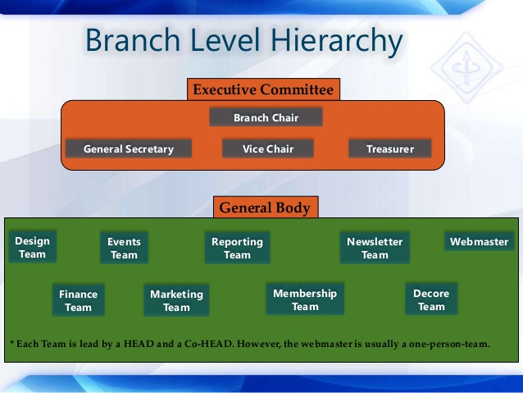
SB Hierarchy

Slide 5
Officer Reporting

Slide 6
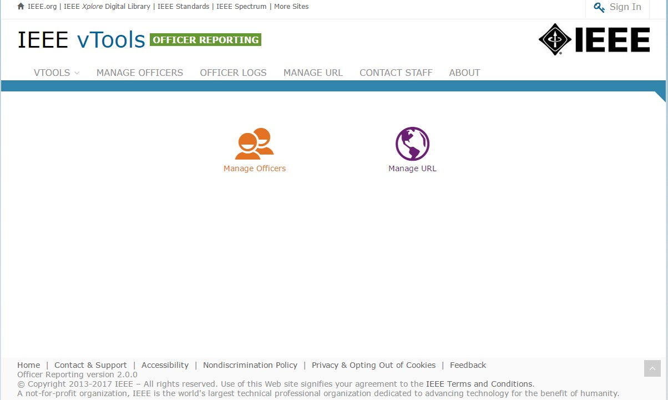
Sign in
Select “Manage Officers” to view and report officers for an organizational unit.
You must be signed in to report officers or manage a URL.
Select “Manage Officers” to view and report officers of an organizational unit.

Slide 7
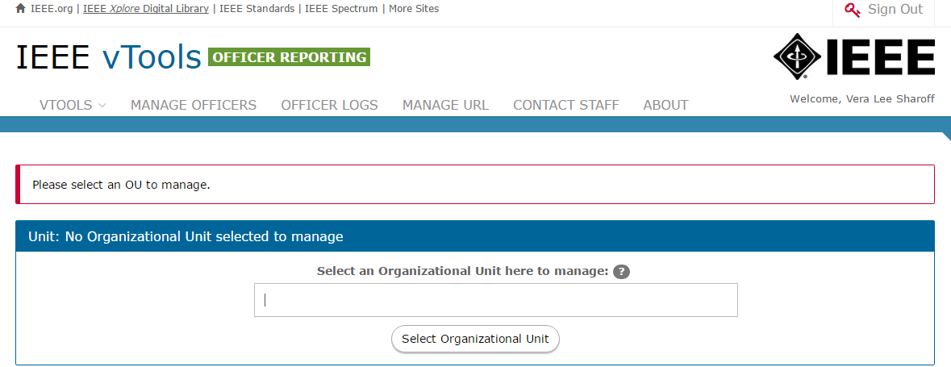
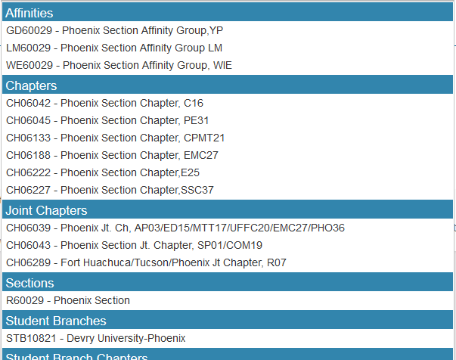
Select Organizational Unit
Enter name/SPO ID or Geocode
of organizational unit in text box.
A list of matches will be shown.
Click on name in list to select organizational unit and retrieve officer roster and URL.

Slide 8
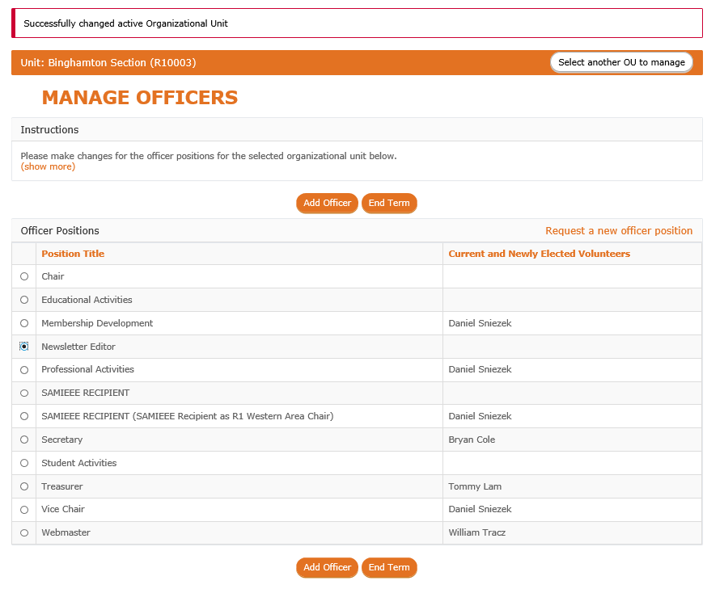
Manage Officers - Organizational Unit roster
MANAGE OFFICERS
– Allows you to view officers, add a new officer and end term of an individual officers for a selected position in the organizational unit selected.
Select Position and click on “Add Officer” to add a new officer to selected position.

Slide 9
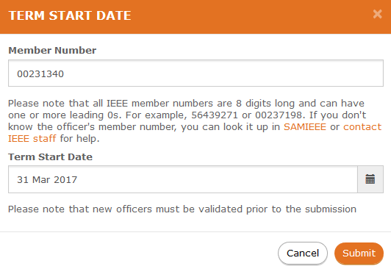
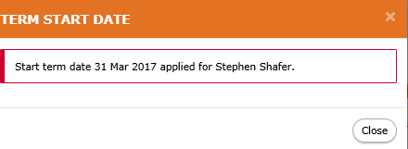
Add Officer number and term date
Enter member number and
Term Start Date.
Click on “Submit” to validate.
The system will retrieve member data and validate that (s)he is eligible to serve in the position based on IEEE rules.
Confirmation.

Slide 10
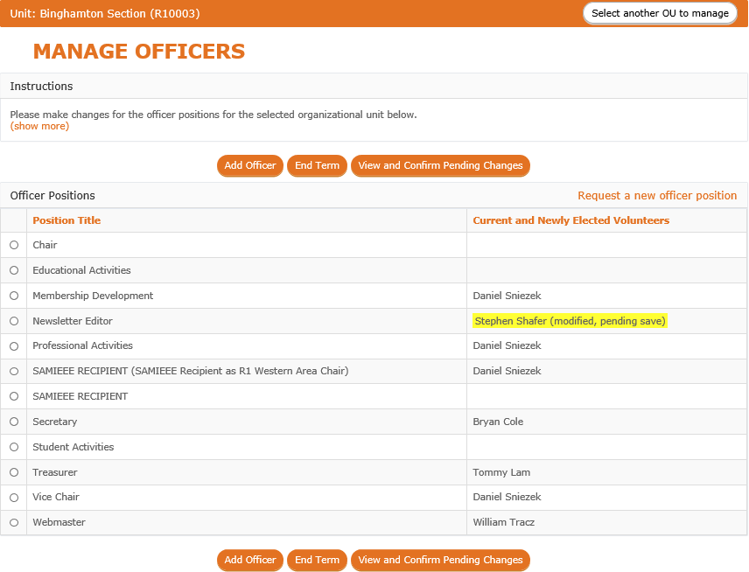
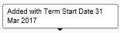
Manage Officers -
Pending changes for a position
Select “View and Confirm Pending Changes” to review and submit changes.
Note multiple changes can be made before clicking on "View and Confirm Pending Changes".
Officer name is now highlighted to show changes are pending.
Note – tooltip includes details of change.

Slide 11
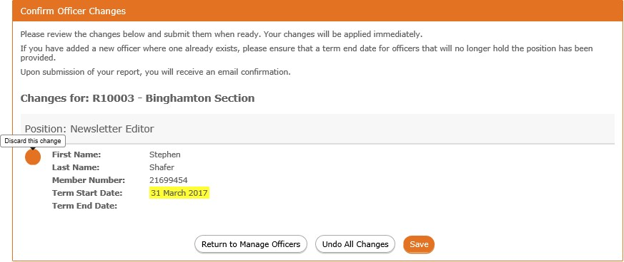
Manage Officers - Confirm Officer Changes
If you are an officer of the organizational unit in which this report is for, your changes will be made immediately. Otherwise, changes will be reviewed by staff before taking effect.
A list of changes will be shown.
Click “Save” to confirm all changes.
Click “Undo All Changes” to discard all pending changes.

Slide 12
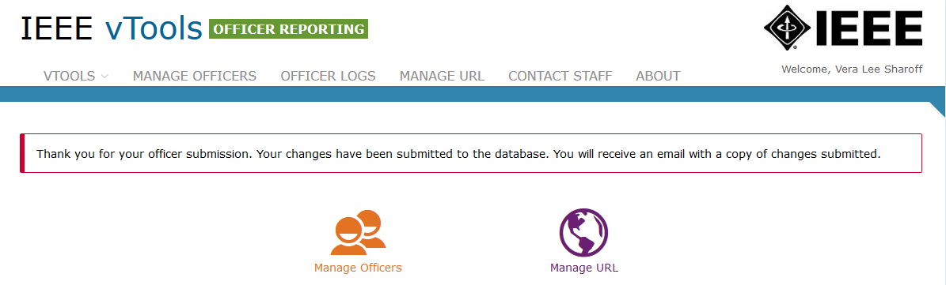
Manage Officers - Confirmation of report

Slide 13
Publish an Event through Vtools

Slide 14
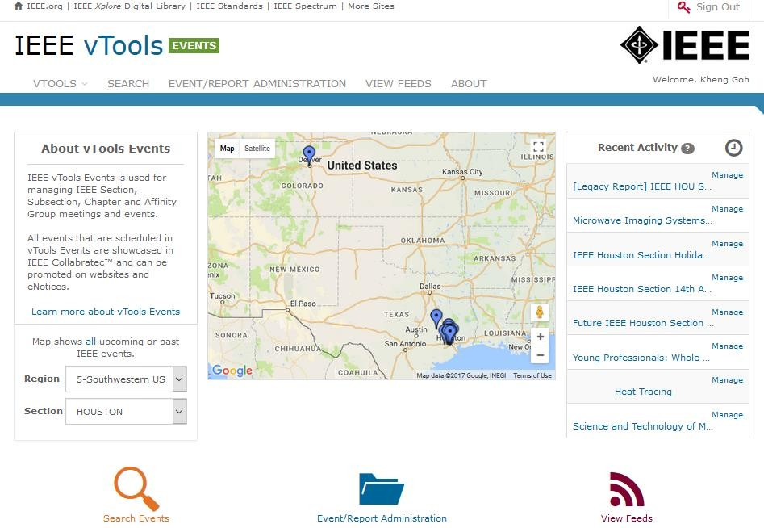
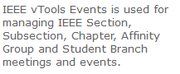
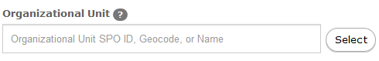
Publish An Event
You must be signed in to create/edit an event.
Select “Event/Report Administration” to access volunteer options – Schedule a New Event
Click on the “Event/Report Administration” icon.
3

Slide 15
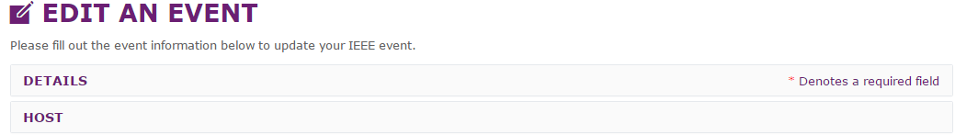
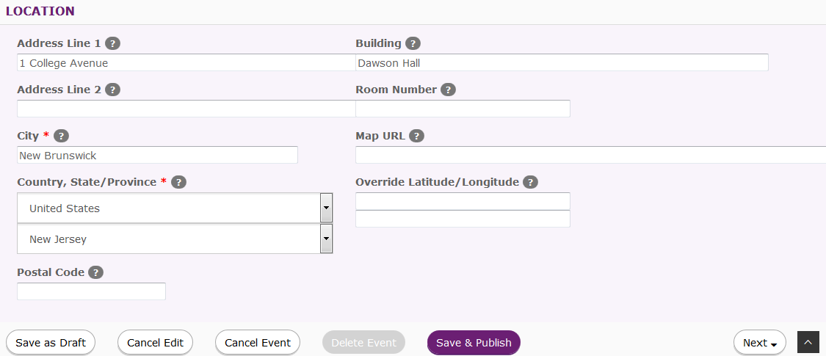
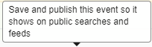
Edit Event – Save & Publish
Edit a draft event and publish it by clicking ‘Save & Publish’
4
Click on “Save & Publish” to save and publish the event.

Slide 16
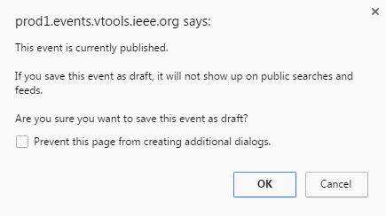

Save Published Event as Draft
Save published event as a draft event.
5
Click on “Save as Draft” to save the event as draft.

Slide 17
File a Report for an Existing Event – Recent Events tab

Slide 18
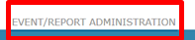
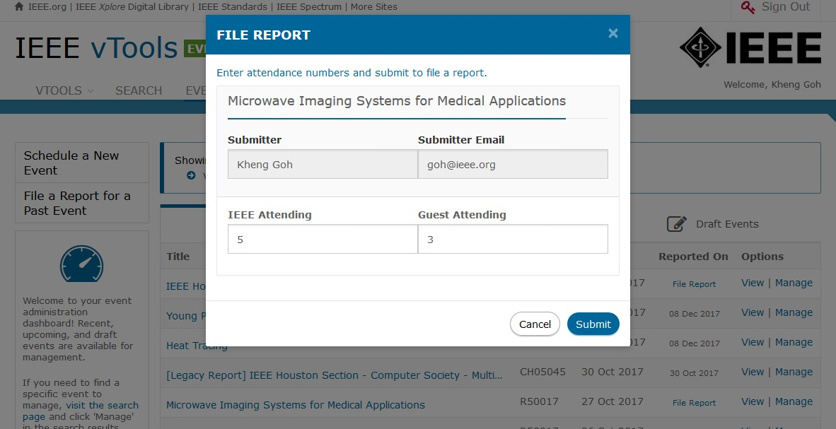
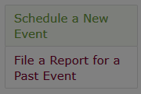

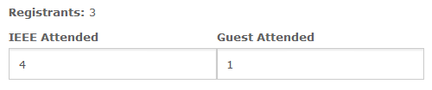

Recent event - File Report option
Enter
attendance
Click on “File Report” to open report.
3

Slide 19
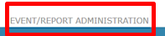
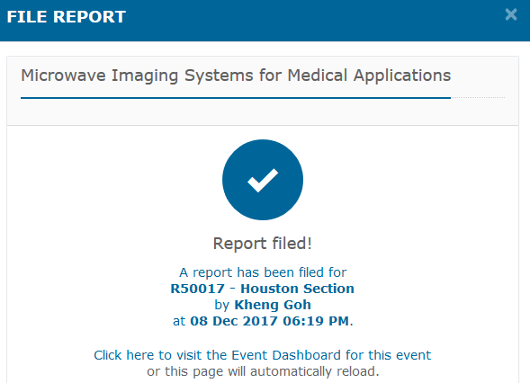
Recent Event – File Report
Note - you may edit the event and report up to 7 days from the
submission date.
4
If you need help, send email to l31-help@ieee.org for assistance.

Slide 20
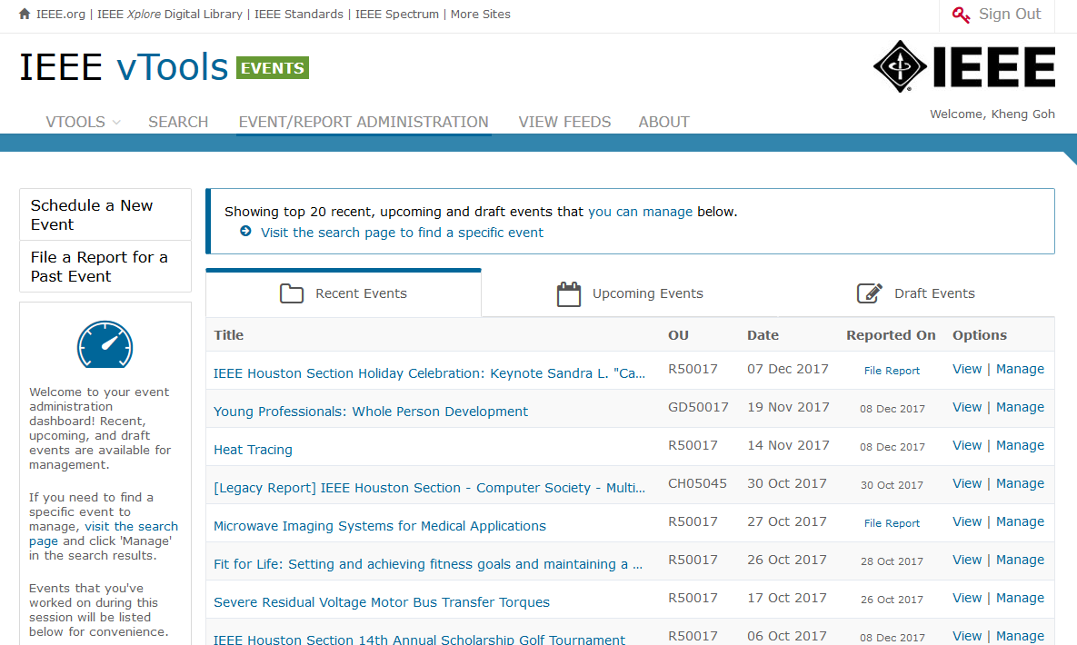
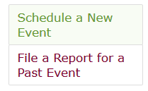


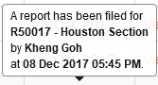
Recent Events - Report Information
You must be signed in to file a report.
The Reported On option “File Report” opens report (L31).
Date indicates when a report has been submitted.
5

Slide 21
Student Branch Annual Plan Reporting

Slide 22
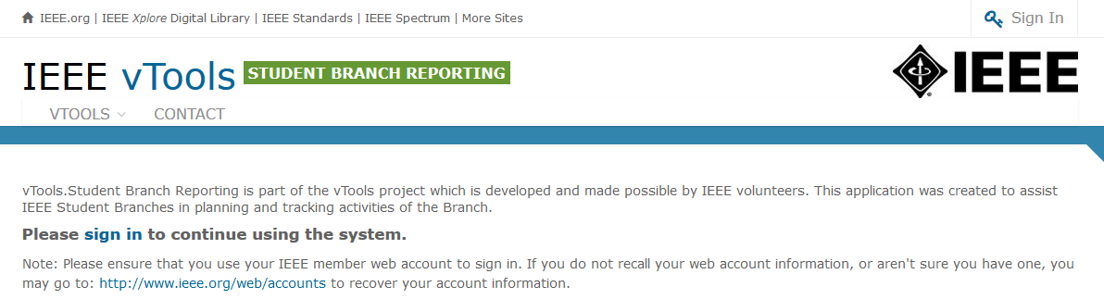
Sign In
You must be signed in to access volunteer options - create a new annual plan.

Slide 23
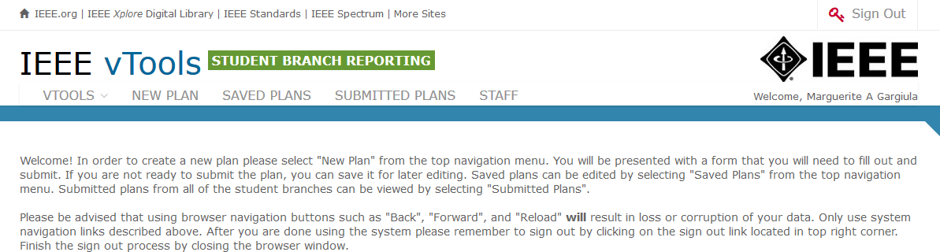


Student Branch Annual Plan
Select “New Plan” to open new plan form.
Click on ‘Submitted Plans’ to
view and download PDF version.
Click on ‘Saved Plans’ to edited plans that have been saved and not submitted.

Slide 24
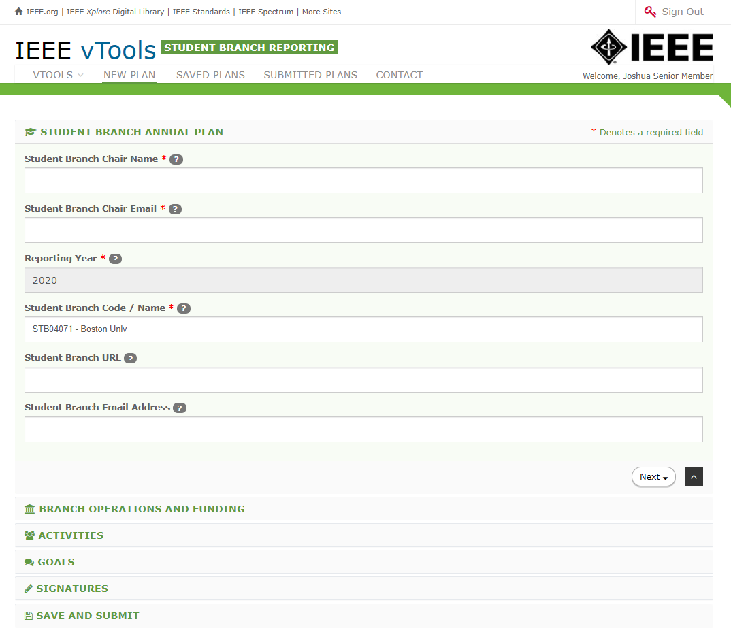
New Annual Plan
Note: Fields marked with an asterisk (*) are required.
For additional help, hover cursor over question mark (‘?’) for hints.

Slide 25
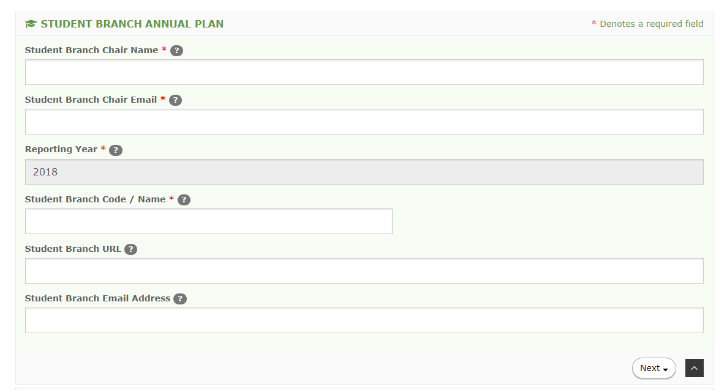
Student Branch Code / Name
Note: Fields marked with an asterisk (*) are required.
Student Branch Annual Plan –
Reporting Year is be read only.
Student Branch Code / Name –
Value displayed will be based on volunteer signed in.
For additional help, hover cursor over question mark (‘?’) for hints.

Slide 26
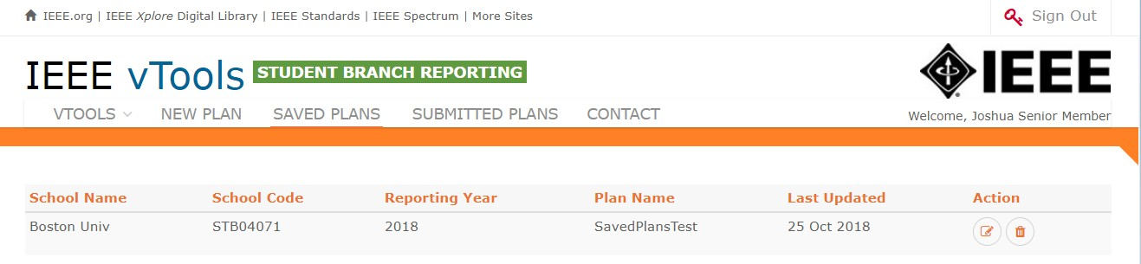

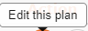



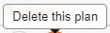
Saved Plans
Click on “Schedule a New Event” to open event form.

Slide 27
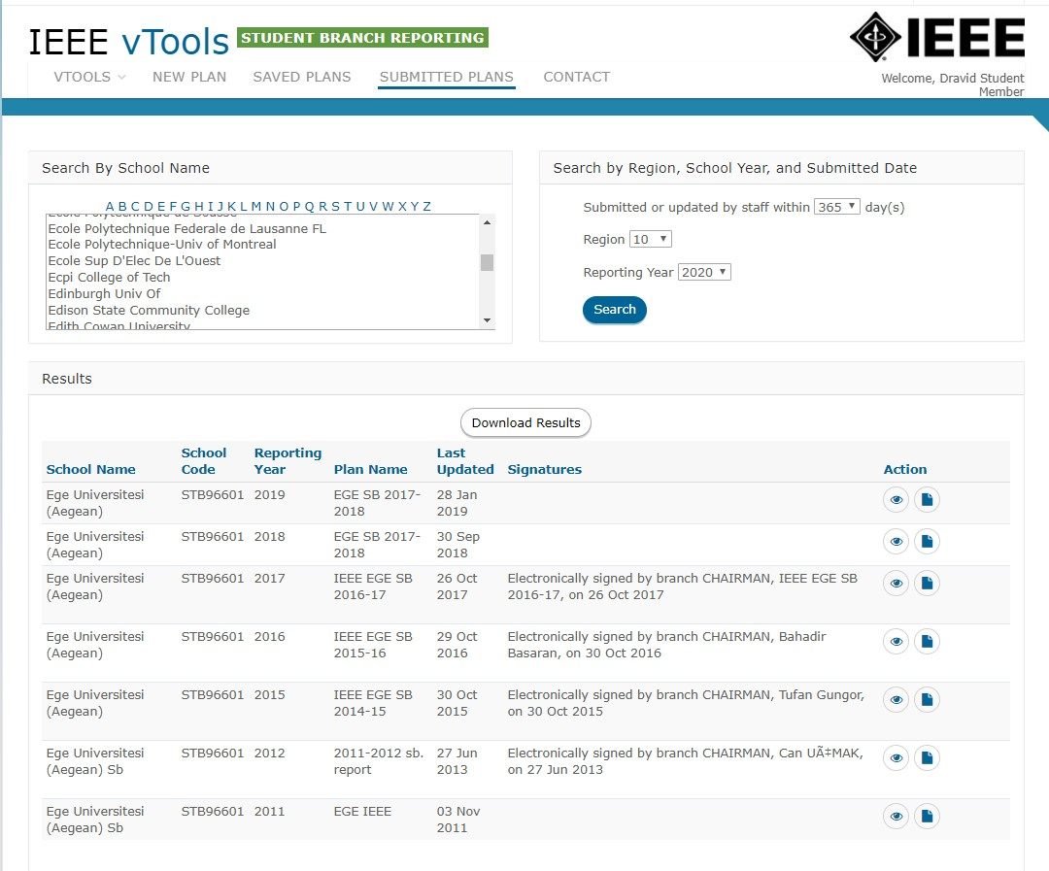



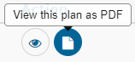



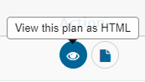

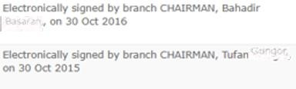
Submitted Plans (Search by Name, Reporting Year and download PDF)

Slide 28


Slide 29
IEEE Collabratec
IEEE Collabratec builds upon those features and offers more ways to access information and people.
Distinct professional identity, through your professional profile and IEEE Member badging
Access the IEEE Member Directory, a listing of over 250,000 members
Member-only searching criteria: Discover other members in your local Section/Region
Participate in IEEE Mentoring program
Access to members-only communities and IEEE-sponsored communities on hot topics
Take advantage of groups by creating more groups with a larger number of participants per group
Personalized certificate of IEEE membership available for PDF download and display, refreshed annually

Slide 30
Key Elements
Umbrella Message: integrated experience, new tool, digital connection, collaboration, community, creation, tools to aid publishing, global engineering/technology focus, distinguished, one suite/hub
Members: networking, connecting, career development, assist production, new opportunities, one suite/hub
Volunteers: easier process to connect, get things done, engagement, one suite/hub
Authors/Researchers: easier workplace, time saver, assist productivity, collaboration, connection, one suite/hub
Institutional Customers / academia: added value; collaboration, global, connection, teams without boundaries, time saver, assist productivity, easier workplace, one suite/hub
Institutional Customers / corporate: proprietary communities; multi-faceted collaboration, teams without boundaries, free tools, time saver, assist productivity, one suite/hub
Technical Activities: community builder; build and manage professional network, knowledge sharing, technically current, one suite/hub

Slide 31
Stay current with the IEEE…
Officer Reporting: https://officers.vtools.ieee.org/
Activity Reporting: https://sbr.vtools.ieee.org/
Student Benefits: www.ieee.org/students
Webinar trainings: http://bit.ly/ieeewebinars
Meeting submission L31: https://meetings.vtools.ieee.org/main
Webex Request:
https://vtools.ieee.org/webex-registration/

Slide 32


Contact IEEE Student Services…
Global Student Facebook Page:
https://www.facebook.com/IEEEStudents?ref=hl
Website: IEEE Students:
www.ieee.org/students
E-mail: student-services@ieee.org
Twitter: www.twitter.com/IEEE_Students

Slide 33





Patience Appreciate Recognition Reward Award

Slide 34


Slide 35

sacieeehyd@ieeehyd.org

